Slide 1

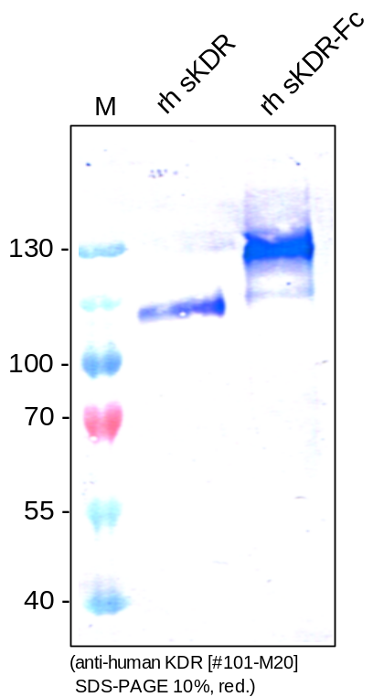
ReliaTech GmbH
Mouse anti-human VEGFR-2/KDR (#EIC)
(Cat #101-M20)
Figure 1. Western analysis of recombinant human sKDR(D7) [Cat# S01-002] and sKDR-Fc chimera [Cat# SFC-008] using a monoclonal anti-human VEGFR-2/KDR antibody [Cat# 101-M20].
http://www.reliatech.de / orders@reliatech.de

